Slide 1
Lightning Talks
Week 3: Project Plan

Slide 2
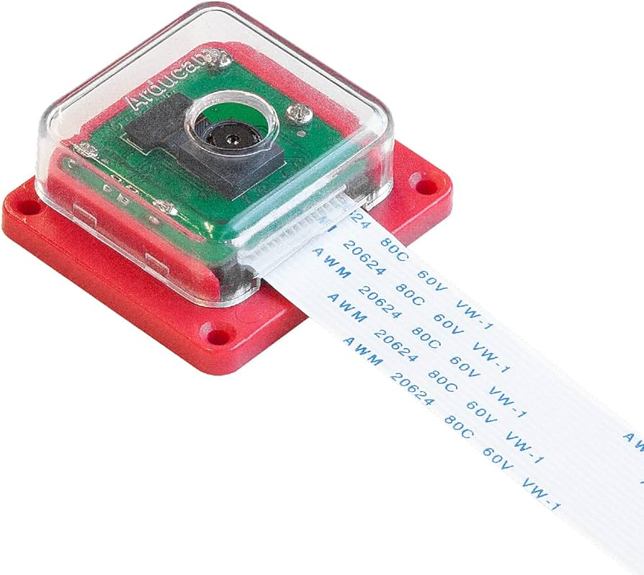
Project Overview
We will be developing a video pipeline from a MIPI-connected COTS camera module to a video monitor
The MIPI video data will be sent through a custom FPGA-based video pipeline
The augmented video will be sent to a monitor connected via an active displayport cable
The software will execute within a Linux operating system
STRETCH GOAL: Video may be passed into a machine learning algorithm and the output of the ML algorithm will be used to augment the video sent to the monitor

Slide 3
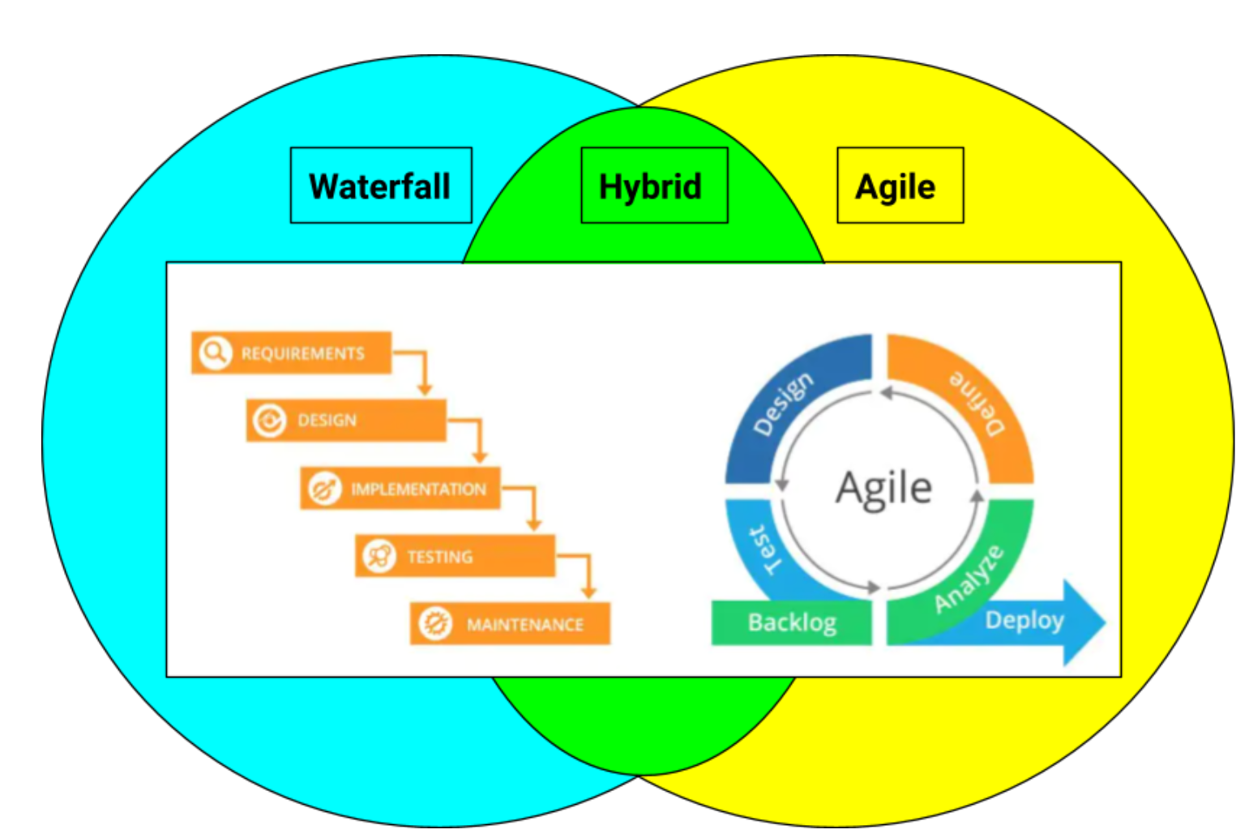
Project Management Style: Agile-Waterfall Hybrid
One weekly scheduled client, advisor, and team meeting
Approximately six or more hours spent on the project per team member each week
Flexibility to add or postpone client or team meetings based on project progress
Using a hybrid style allows for a top-down approach while also allowing for changes when issues arise

Slide 4
Project Management Style (Continued)
Project Management Style (Continued)
Intermittent check-ins from the client for each member of the team
Doing component research first, then rapid design and testing periods
Planning requirements can be large or small based on progress made on component research, code implementation, etc.

Slide 5
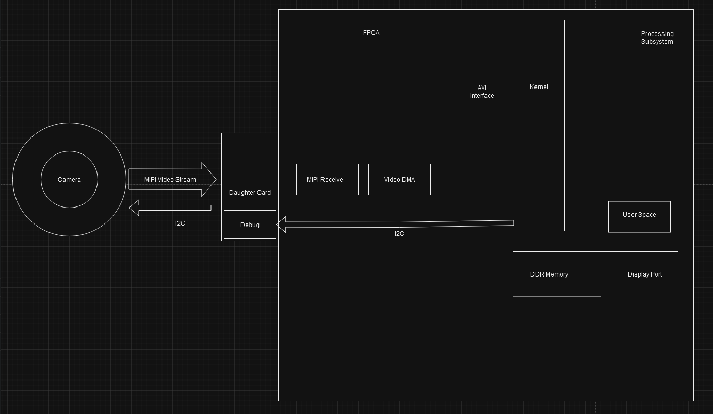
Project Block Diagram

Slide 6
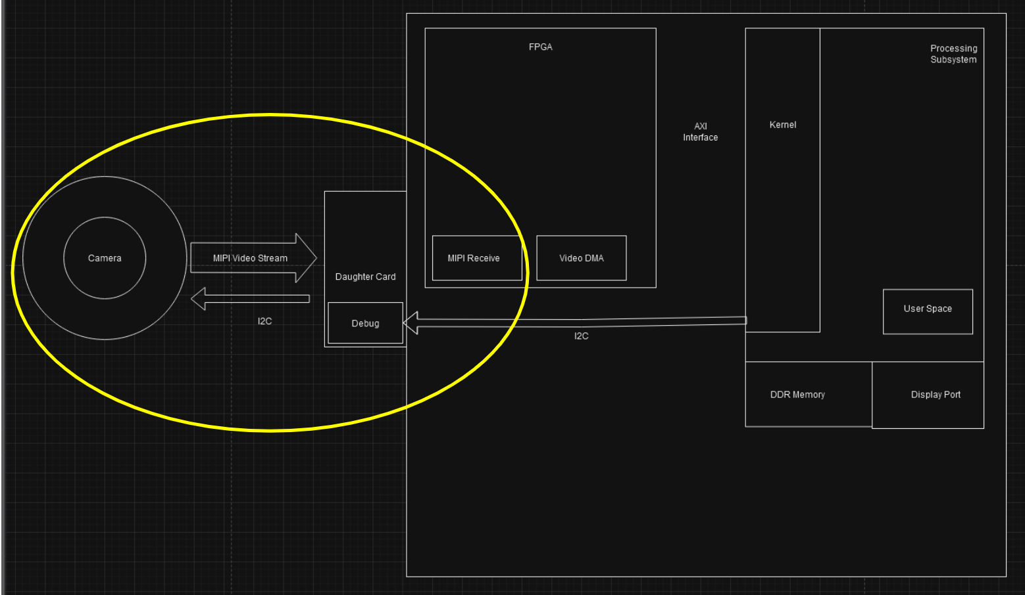
Task Decomposition (High-Level)
Task Lead: Ritwesh - Video Stream to FPGA
Configure the camera properly using the I2C protocol and send video stream data to the MIPI controller on the Ultra-96
Write PYNQ-compatible code that writes to the appropriate I2C port and configures the camera
Read camera datasheet, PYNQ libraries, and find corresponding I2C ports on Ultra-96

Slide 7
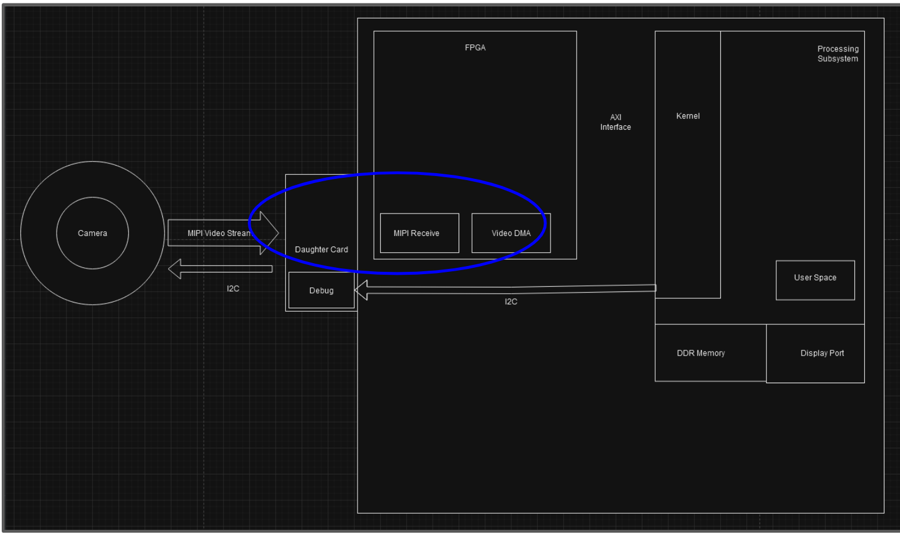
Task Decomposition (Continued)
Task Lead: Deniz - Video Stream to FPGA
Configure the MIPI controller to receive and transmit camera data video stream correctly
Monitor status registers to confirm data is being handled correctly
Understand configuration requirements for input and output streams

Slide 8
Task Decomposition (Continued)
Task Lead: Liam - VDMA to DDRM
Goal: Utilizing AXI VDMA on the Ultra-96 to allow direct memory access between memory and AXI4 video stream data
Properly connecting the VDMA to DDRM and the CSI-2 module
Understand the interfaces of the AXI4-Stream and the memory modules
Create a system to hand off video data to the test pattern generator through memory
Properly configure the VDMA using AXI4-Lite interface
Understand the requirements and limitations of the AXI4-Stream and the memory interfaces
Understand the AXI4-Lite configuration registers

Slide 9
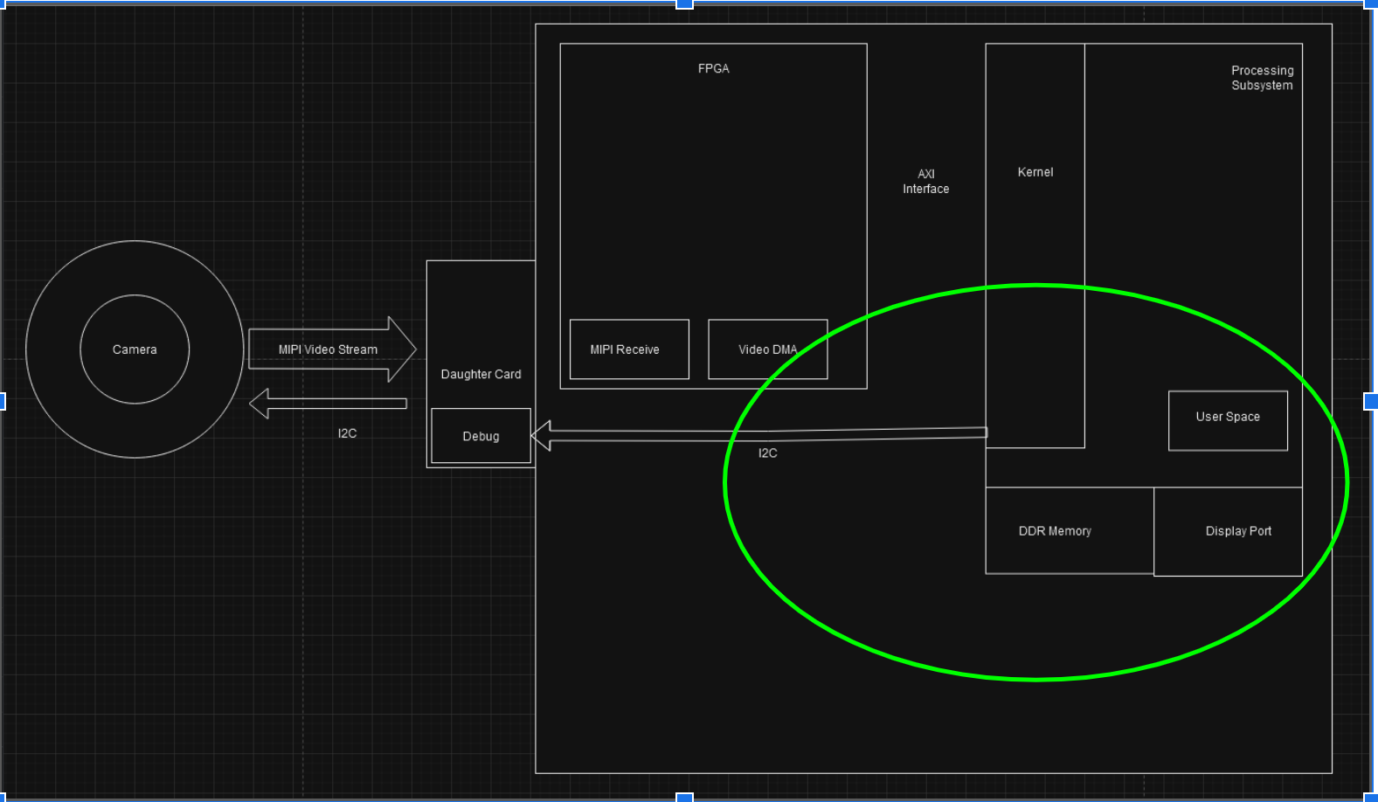
Task Decomposition (Continued)
Task Lead: Taylor - DDRM to Output Display
Video buffered in DDR memory on the Ultra-96 must be output to a display monitor.
Configure the displayport IPs
Read datasheets for the TPG, Video Timing Controller, Axi4 Stream-to-Video Out
Determine the appropriate register configurations.
Understand how data is being transferred from DDRM to the display.
Use PYNQ libraries to read from and allocate memory.

Slide 10
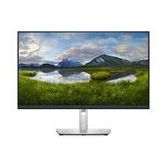
Key Milestones, Metrics, and Evaluation Criteria
Milestone: Output the camera video stream data to a display monitor using a Linux environment
Metrics:
Video stream data is output with a predefined resolution and frame rate, such as 1080p and 30 fps.
Video stream data is output in the correct pixel-array format, such as 3280x2464 (as intended).
Notes:
The product will need to work in a variety of lighting conditions and will need to withstand wear and tear from normal weather conditions. This is due to the fact that one application for this product will be to mount it to a motorized wheelchair to help someone with a disability. This means that this device will need to be both durable, consistent, and reliable in order for it to be useful. This device will be required to compute machine learning in real time. This is important because the product will be actively and constantly throughout the day. Immediate response is necessary in order to reliably aid in communication and navigation.

Slide 11
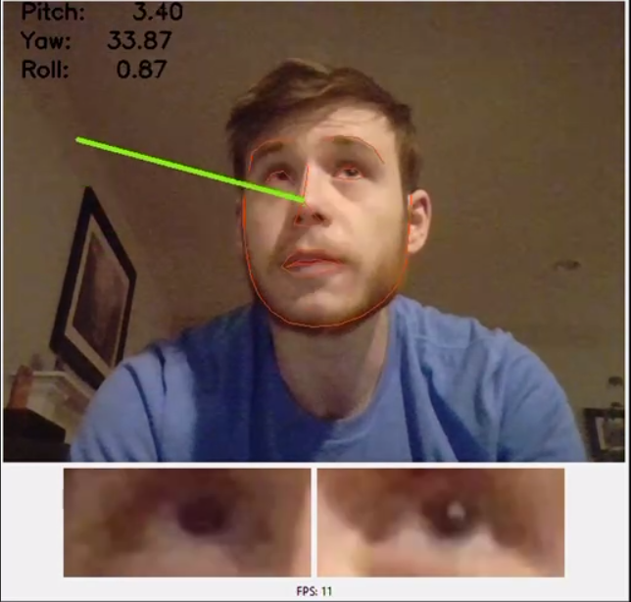
Milestones, Metrics, and Evaluation Criteria (Continued)
STRETCH GOAL: Pass video stream data through a Machine Learning (ML) algorithm, in which the output of the ML algorithm augments the data.
Metrics:
If the ML algorithm is tracking eye movement for both eyes and given a known ground truth bounding box containing a person’s eyes, the IOU (intersection over union) of the predicted bounding box should be
IoU > 0.5 (is “decent”)
IoU > 0.7 (is “pretty good”)
IoU > 0.9 (is “almost perfect”)
Given a known ground truth video stream not obstructed by glare and if the ML algorithm reduces glare on an obstructed video stream, computing the SNR (signal-to-noise ratio) of the ML video and ground truth video can help determine how well the algorithm performed.

Slide 12
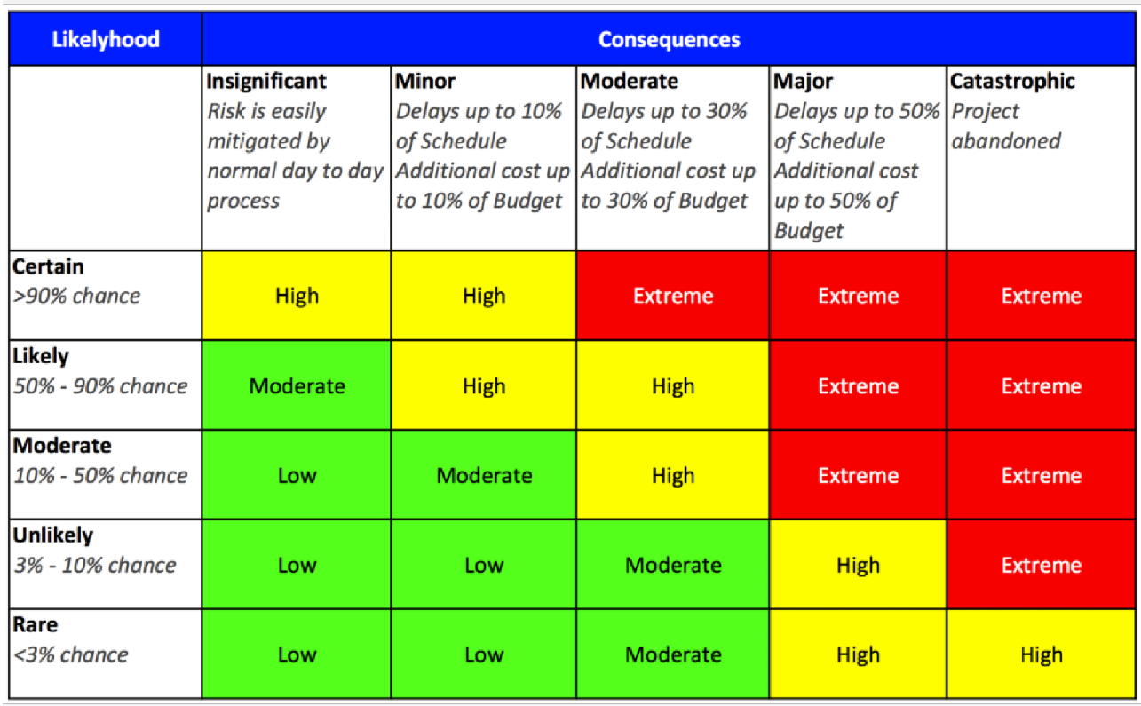
Key Risks and Risk Management Strategies
There are low safety risks associated with handling the Ultra-96 and its software. The maximum voltage supplied to the Ultra-96 is 12 V, so electrical hazards are limited.
There are some small chances the hardware is not working and may need replacement. In this case, the team will reach out to the client and class professors to determine ways of fixing the issues in a timely, cost-effective manner.

Slide 13
Key Risk and Risk Management Strategies (Continued)
Depending on the team’s progress on the first objective of outputting video stream data in a Linux environment, some low to moderate chances may delay our stretch goal of using an ML algorithm. Furthermore, there are some non-zero chances of implementing the algorithm that may prove more difficult than predicted.
If the team is not satisfied with its progress with the project goals, we may contact our client, faculty advisors, and ECpE faculty for technical assistance.
Furthermore, we may alter our original ML algorithm task to ensure that we can realistically accomplish it between now and the end of our Senior Design Project.

Slide 14
Conclusion
This product implements a video pipeline for a computer vision system in C and Python code working on a Linux image. The hardware is off-the-shelf, commonly available components and sensors designed to aid disabled or injured users. Additionally, our project management style is a mixture of Waterfall and Agile, two management styles we learned about in class. Our project consists of several tasks and smaller subtasks, key milestones and metrics to assess our progress, and more or less probable risks we have provided ways of addressing.

